Slide 1
CSE 1102 Fundamentals of Programming Lecture #14
Spring 2017
Computer Science & Engineering Program
School of Electrical Engineering & Computing
Adama Science & Technology University

Slide 2
Outline
Structures and Classes Practice
Employee Record
Practice Exercises 1
Continuing the Date Class
Elevator Class
Practice Exercises 2

Slide 3
Employee Record
Write a definition for a structure type for records consisting of a person’s wage rate, accrued vacation (which is some whole number of days), and status (which is either hourly or salaried). Represent the status as one of the two char values ’H’ and ’S’. Call the type EmployeeRecord.

Slide 4
Practice Exercises 1
Consider the following type definition
What will be the output of the following

Slide 5
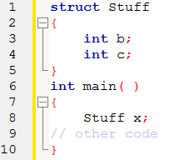
Practice Exercises 1
What is the error in the following code

Slide 6
Continuing the Date Class
Add a member function named convert() to the Date class in Lecture 13 that does the following:
The function should access the month, year, and day data members and return a long integer in the form yyyymmdd that’s calculated by using an algorithm

Slide 7
Continuing the Date Class
yyyymmdd = year * 10000 + month * 100 + day
For example, if the date is 4/1/2014, the returned value is 20140401.
(Dates in this form are useful when performing sorts because placing the numbers in numerical order automatically places the corresponding dates in chronological order.)

Slide 8
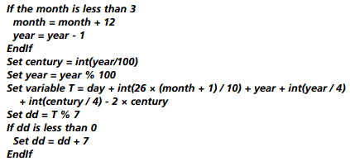
Continuing the Date Class
Add a Date class function named dayOfWeek() that returns the day of the week for any date that’s provided. Zeller’s algorithm is used for determining this information:

Slide 9
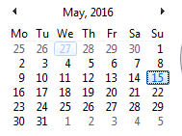
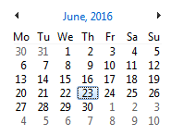
Continuing the Date Class
Using the Zeller’s algorithm, the variable dd has a value of 0 if the date is Saturday, 1 if the date is a Sunday, 2 if a Monday, and so on.
For example, the date 5/15/2016 should return a 1, and the date 6/23/2016 should return a 5
Put all the additional functions in a complete program and test whether they work correctly

Slide 10
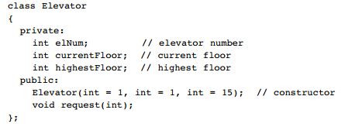
Elevator Class
Complete the following class by including functions corresponding to the two prototypes listed in the declaration section:

Slide 11
Elevator Class
In this definition,
the data member elNum is used to store the elevator’s number,
the data member currentFloor is used to store the elevator’s current floor position, and the data member highestFloor is used to store the highest floor the elevator can reach.
The constructor should allow initialization of an object’s three data members with the data passed to the constructor when an Elevatorobject is instantiated.

Slide 12
Elevator Class
The request function should code the following algorithm:
If a request is made for a nonexistent floor, a floor higher than the
topmost floor, or the current floor
Do nothing
ElseIf the request is for a floor above the current floor
Display the current floor number
While not at the designated floor
Increment the floor number
Display the new floor number
EndWhile
Display the ending floor number
Else // the request must be for a floor below the current floor
Display the current floor number
While not at the designated floor
Decrement the floor number
Display the new floor number
EndWhile
Display the ending floor number
EndIf

Slide 13
Elevator Class
Include the Elevator class written in a complete program, and verify that all member functions work correctly.

Slide 14
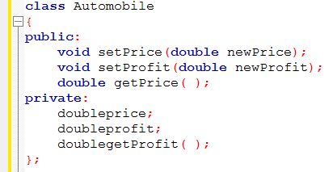
Practice Exercises 2
Suppose a program contains the following class definition
And suppose the main function contains the following declarations and that the program somehow sets the values of all the member variables to some values

Slide 15
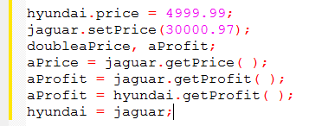
Practice Exercises 2
Which of the following statements are then allowed in the main function of your program?

